Slide 1
Tonight
1) Where we are
2) Article Presentation(s)
3) Quiz
4) Lecture
5) In-class lab(s)

Slide 2
Access Control and Physical Security
IS 380
Chapter 4
(Class 3)

Slide 3
CIA Review
Availability
Integrity
Confidentiality

Slide 4
Access Control
How we provision resources
In large scale environments, use identity management (IdM)
Covers a wide variety of technologies – every system has a way to provide access

Slide 5
3 steps to providing access
Identification – The subject indicates who they are (username, badge, other public info)
Authentication – The subject provides information only they would know or have (PIN, password, fingerprint, cryptographic key)
Authorization – the system determines where the subject can go

Slide 6
Multi-factor authentication
Use two or more of:
Something you are
Something you know
Something you have
Provides a stronger security model

Slide 7
Authentication methods
Biometrics (Palm scan, iris scan, facial recognition, voice print, signature dynamics)
Passwords (How do we secure them?)
Token devices
Digital signatures (PGP)
Notes:
P179

Slide 8
Biometrics
Type I error – false rejection
Type II error – false acceptance rate
CER - crossover error rate – the point where the rejection rate equals the false acceptance rate. Lower is better.
Iris scan – highest accuracy potential

Slide 9
Passwords
Most common and one of the weakest
Password checker - L0phtcrack
Password cracker - Rainbow tables –basically a reverse lookup table.
http://www.freerainbowtables.com/en/tables/ntlm/ 1.5TB for NTLM. 99.9% success rate.
REF: http://project-rainbowcrack.com/tutorial_gui.htm
Are your passwords using Salt?
Unix was 12-bit
Notes:
P184
More on salts: http://en.wikipedia.org/wiki/Password_cracking

Slide 10
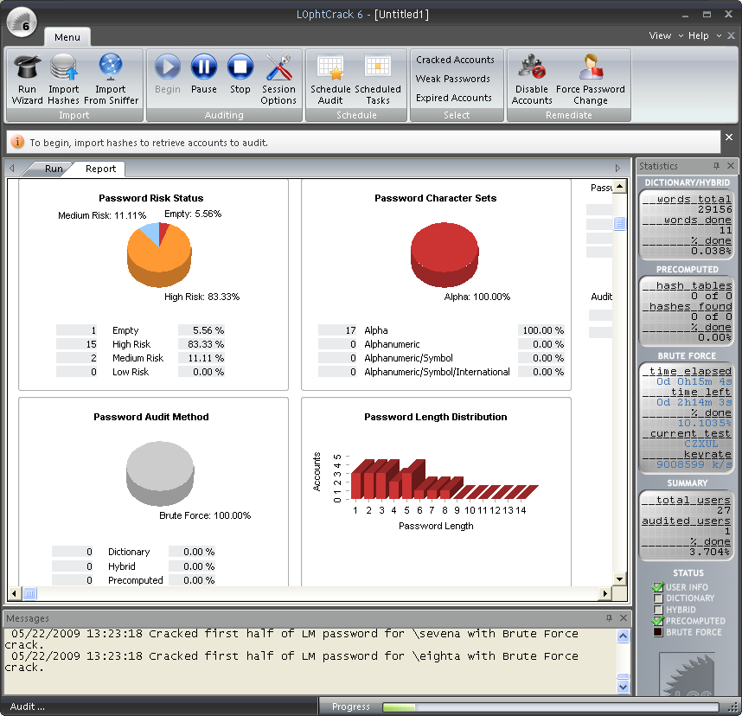

Slide 11
Password management
Password synchronization
Self-service password reset (Cognitive password?)
Assisted password reset
Single-sign on
Notes:
p185

Slide 12
Token Devices
RSA/Authentix, etc
Bloomberg token

Slide 13
Smart Card
Not a memory card (swipe card to enter a building), but could be coupled with one. Stevenson card is a memory card.
Prox cards suck.
Smart card has a small CPU on it. 2-factor auth (PIN).
Contact – insert into a card reader
Contactless – has an antenna.
Microprobing?
Notes:
P191
Microprobing is on p194

Slide 14
Authorization
Access criteria may include:
Roles – job assignment/function
Groups
Physical or logical (network address) location
Time of day
Transaction type
Notes:
p195

Slide 15
Authorization (Continued)
Default to no access
Need to know (Least privilege)
Single sign-on models (Kerberos, thin clients...)
Authorization creep
Notes:
p196

Slide 16
Kerberos
Uses symmetric crypto
KDC (Key Distribution Center) – holds all keys. EVERYONE TRUSTS THE KDC
Principals – users, computers, services, etc.
Ticket – Ticket Granting Service on KDC gives a principal a ticket to authenticate to another principal.
Services never contact the KDC.
Notes:
p202

Slide 17
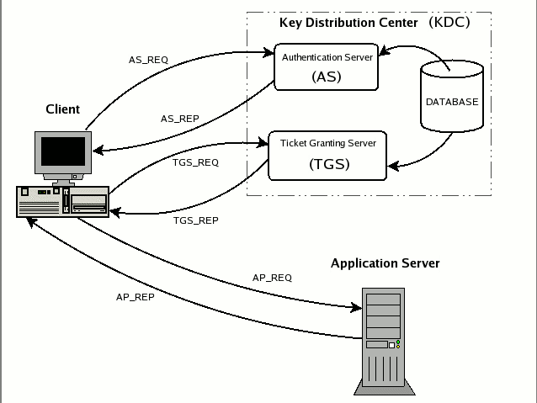
Login
TGT
TGT & Service ticket request
Service Ticket & Service session key
Application Request (Ticket & Session key)
Server Authentication reply (optional)
Notes:
REF: http://www.kerberos.org/software/tutorial.html
It is important to underline that an application server never communicates directly with the Key Distribution Center: the service tickets, even if packeted by TGS, reach the service only through the client wishing to access them. The messages we will discuss are listed below (see also the figure below):
AS_REQ is the initial user authentication request (i.e. made with kinit) This message is directed to the KDC component known as Authentication Server (AS);
AS_REP is the reply of the Authentication Server to the previous request. Basically it contains the TGT (encrypted using the TGS secret key) and the session key (encrypted using the secret key of the requesting user);
TGS_REQ is the request from the client to the Ticket Granting Server (TGS) for a service ticket. This packet includes the TGT obtained from the previous message and an authenticator generated by the client and encrypted with the session key;
TGS_REP is the reply of the Ticket Granting Server to the previous request. Located inside is the requested service ticket (encrypted with the secret key of the service) and a service session key generated by TGS and encrypted using the previous session key generated by the AS;
AP_REQ is the request that the client sends to an application server to access a service. The components are the service ticket obtained from TGS with the previous reply and an authenticator again generated by the client, but this time encrypted using the service session key (generated by TGS);
AP_REP is the reply that the application server gives to the client to prove it really is the server the client is expecting. This packet is not always requested. The client requests the server for it only when mutual authentication is necessary.

Slide 18
Access Control Technologies
Directory services (Active Directory)
Web access management
Password management
Single sign-on
Notes:
p209

Slide 19
Directory services
A collection of unique objects
Each object has a series of attributes
Controls Identification, authentication, and access control rules

Slide 20
Access control models
Discretionary access control (ACL’s, user assigned rights, i.e. Windows)
Mandatory access control (Security labels are assigned by classification level, and users must be at that level or higher and satisfy need-to-know. Controlled by the OS)
Role-Based access control – Defining what each role in the company does and assigning rights as a group
Notes:
P210

Slide 21
Access Control Techniques
Rule-based (if X, then Y)
Constrained user interfaces (Restricted database views)
Content-dependent (object content – SS#)
Context-dependent (Firewall and TCP setup)
Notes:
P216
Content/context on p220

Slide 22
Access Control Techniques (Cont.)
Capability tables vs. ACLs
Both are forms of access matrices
Capability tables are applied to subjects (People)
ACLs are applied to objects (hardware)
Notes:
P219-220

Slide 23
Accountability
Auditing
System level, Application level, user level events
Protect audit logs
Scrubbing?
WORM media . . . Syslog . . .etc.
Post-breach is too late to start auditing
Need to establish clipping levels
Notes:
p242

Slide 24
Auditing tools
Audit reduction tool – removes mundane events
Variance detection
Attack-signature detection

Slide 25
Controls
Administrative – Personnel, Supervisory, Training
Technical – Network architecture, encryption
Physical – Perimeter security, work area separation, network segregation

Slide 26
In-Class Lab
Define an access control security policy for logging onto windows-based systems
You will be either a military, educational, or corporate entity
Define administrative, physical, and technical controls
Reference Harris 237-242

Slide 27
Access control monitoring
IDS/IPS (Network or host based)
Signature based no 0-day
Anomaly (Statistical/Protocol anomaly, traffic anomaly) 0-day
Rule based – if/then and draws on a knowledgebase – no 0-day
Honeypot – liability
Network sniffers
Again, we are looking for anomalies from our baseline

Slide 28
Access Control threats
Dictionary Attack
Brute force attack
Logon spoofing (Stealing credentials)
Phishing attacks
Identity theft
http://survey.mailfrontier.com/survey/quiztest.cgi?themailfrontierphishingiqtest

Slide 29
TEMPEST
Electromagnetic emanations
Faraday cage
White noise
Control zone (metallic paint, etc)

