Slide 1
Cryptography
IS 380

Slide 2
What is Cryptography?
Method for storing and/or transmitting data in a form that only those it is intended for can read it.
Protect information from others by making it unreadable.
OR
Make it take so long to crack that it’s effectively secure.

Slide 3
History
Atbash – Hebrew substitution cipher
abcdefghijklmnopqrstuvwxyz
ZYXWVUTSRQPONMLKJIHGFEDCBA
Scytale – Spartan. Message on papyrus wrapped around a staff.
Caesar – shift letters three spaces (substitution)

Slide 4
History (cont)
Vigenere table – ‘table’ and ‘key’ shared in advance
Enigma machine – rotors, plug board, reflecting rotor. Initial settings and advancing the rotors with each step provided the ‘shared key’.
Notes:
P668

Slide 5
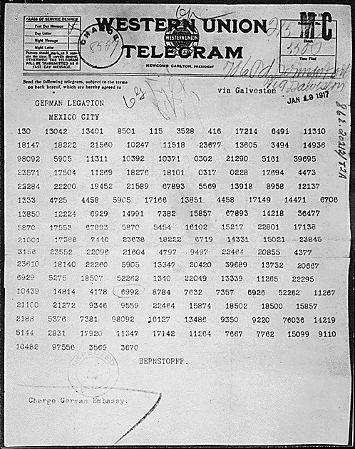
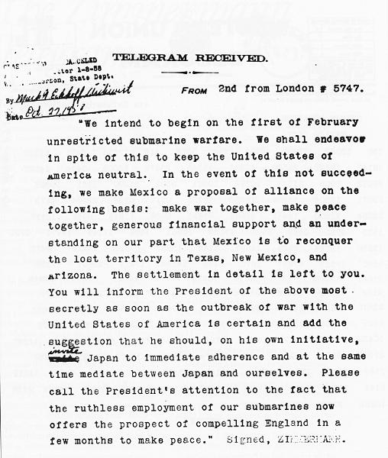
Zimmerman telegram

Slide 6
William Friedman
The Index of Coincidence and Its Applications in Cryptography

Slide 7
History (cont)
Lucifer – IBM equations and functions, modified by the NSA and rebranded DES (1976)

Slide 8
Cryptoanalysis
The science of studying and breaking encryption
Identify flaws and weaknesses
Find ‘back doors’ to ‘break’ encryption.

Slide 9
Encryption terms
Plaintext – text that is not encrypted and can be easily read.
Ciphertext – encrypted text that can not be read.
Cryptosystem – a method (algorithm) used to turn plaintext into ciphertext.
Algorithm the set of rules; the ‘cipher’
Key – the secret information used by the cipher to turn plaintext into ciphertext and back again.

Slide 10
Encryption terms (cont)
Keyspace – the range of all possible keys.
Bigger is better
The more random the key, the better
Strength – secrecy of the key, the cipher, key length, initialization vectors
how hard it is to decrypt the information/recover the key.
Work factor – the effort and resources needed to break the crypto

Slide 11
Cryptography provides. . .
Confidentiality
Integrity
Authentication
Authorization
Nonreprudiation
Notes:
P675

Slide 12
Kerckhoffs’ Principle
The only secret in a cryptosystem should be the key.
If there are too many secrets, there would likely be more vulnerabilities to exploit.
Many heads are better than one (when creating a cipher algorithm).
Notes:
p672

Slide 13
One-Time Pad
Vernam cipher ‘unbreakable’
Key and the message are the same length
Used only once
Distribution of the key must be ‘secure’
Pad must be completely random
Highly secure
Highly cumbersome

Slide 14
Steganography
Hiding data within other data
Hide data within documents, pictures, music files, even programs.
Carrier – what contains the hidden information
Payload – the information that is concealed.
LSB – least significant bit – leaves very little distortion to the naked eye. (duplicate colors).
Microdots

Slide 15
Ciphers
Substitution cipher – replaces information/test with other information/text
Caesar cipher
Transposition Cipher – change the order of the information
Most modern ciphers use both methods.
Frequency analysis – some words and letters appear more frequently than other words/letters.

Slide 16
Encryption methods
Symmetric cryptography
Asymmetric cryptography

Slide 17
Symmetric Encryption
Symmetric algorithm – the sender and the receiver use the same key to encrypt and decrypt
Also called secret key.
Each ‘friend’ must have a separate key. N(n-1)/2
Share key ‘out of band’
Fast
Key sharing can be a weakness
Key management can be a mess
Notes:
p686

Slide 18
Asymmetric Encryption
Two keys mathematically related
Private key – not given out to anyone (you keep the private key you generate)
Public key – key is given out freely to anyone and everyone.
Something encrypted with one key needs to use the other key to be decrypted.
Provide authenticity.
‘Secure message format’ & ‘open message format’

Slide 19
Asymmetric Encryption (cont)
Very slow
More math (and CPU) intensive.
Also called public key cryptography
Better key distribution in larger systems
RSA, ECC, Diffie-Hellman

Slide 20
Symmetric implementations
Block cipher
Stream Cipher
Notes:
P691

Slide 21
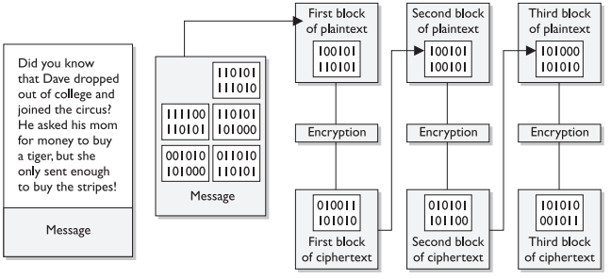
Block cipher
Message is divided into blocks.
Blocks pushed through cipher one at a time.
The key determines the operation and the order

Slide 22
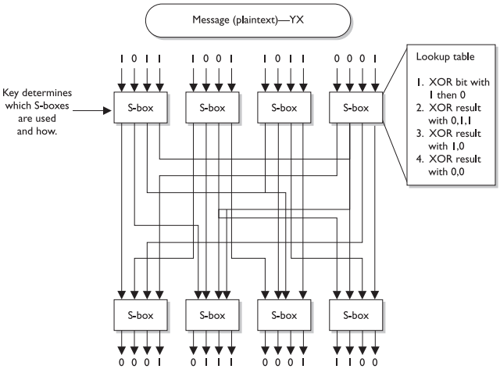
Block cipher II
Two factors used to strengthen the cryptography
Confusion:
substitution
Diffusion:
transposition
Notes:
p693

Slide 23
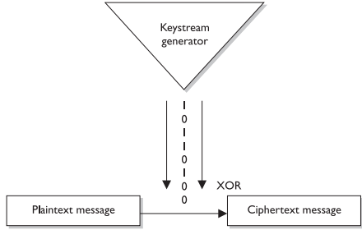
Stream cipher
Message treated as a stream of bits
Operation performed one bit at a time
Keystream generator – produce a stream of bits XORed with plaintext
Notes:
P695

Slide 24
IV – initialization vectors
Random values used with the key
Keep things looking random – eliminate repetition.

Slide 25
Stream cipher II
Stream ciphers require additional randomness to work correctly.
Work better in hardware (ASIC) than software
Require more processing power than block ciphers.

Slide 26
Hybrid encryption
Both asymmetric and symmetric crypto together (usually at different stages).
Symmetric cryptography is used to encrypt a message, then the key is encrypted with asymmetric crypto , attached to the message and sent.

Slide 27
Session key
Symmetric key used to provide encryption for one session
Key is discarded after session ends.
Often used with hybrid crypto. HTTPS, secure e-mail, etc.
Part of the problem with WEP was the use of ‘static’ session keys.

Slide 28
Symmetric cryptosystems
Notes:
p702

Slide 29
DES/ DEA 1977-1988
Data Encryption Standard (Algorithm)
Based on 128-bit Lucifer (IBM)
64-bit with 8 bits parity (56-bit)
Cracked by EFF in 1998 (3-days to go through keyspace)
Replaced be 3DES then AES
It was estimated in 1977 that a computer to crack DES could be built for $20M*
Notes:
*http://en.wikipedia.org/wiki/Data_Encryption_Standard#cite_note-7

Slide 30
DES
64-bit symmetric block cipher (8-bits parity)
Each block of data is put through 16 rounds of transposition and substitution (exactly how depends on the key).
http://nsfsecurity.pr.erau.edu/crypto/

Slide 31
DES modes
Electronic Code Book (ECB) – databases, passwords. Low randomness (no IV).
Cipher Block Chaining (CBC) high randomness, large files. Different IV each time.
Cipher Feedback (CFB) Block & Stream; terminal
Output Feedback (OFB) – protect from bit errors
Counter Mode (CTR) – no chaining, high performance, parallel encryption.
Notes:
p705

Slide 32
3DES
Triple-DES
Stopgap until AES finalized.
48 rounds.
Big performance hit.

Slide 33
AES
Advanced Encryption Standard
Also known as Rijndael.
128,192,256-bit encryption (10-14 rounds)
Performs in software or hardware
Sensitive but unclassified (SBU)

Slide 34
IDEA
International Data Encryption Algorithm
128-bit.
Faster than DES in software
Used in PGP
Well tested

Slide 35
Others
Blowfish – 32-448bit encryption, 16 rounds. Public domain.
RC4 – SSL, WEP (bad implementation), simple, fast, stolen.
RC5 – up to 2048-bit encryption, up to 255 rounds.
RC6 – modified RC5 to make it faster.

Slide 36
Drawbacks to symmetric crypto
Services – confidentiality only.
Scalability – the more people, many more keys.
Key distribution – it’s a problem.

Slide 37
Asymmetric cryptosystems
Notes:
p702

Slide 38
Diffie-Hellman ‘key agreement’
Each party generates a private/public key pair.
Public keys shared.
Key agreement - By combining their private with the other’s public key, both parties come to the same ‘secret key’.
This key is then used as symmetric cryptography to transmit the message.
MITM attack (with no authentication)
Notes:
P714

Slide 39
RSA
Used for digital signatures, key exchange, encryption.
1978
Large prime numbers
Widely used

Slide 40
One-way function
Vastly easier to multiply two large prime numbers than to factor one massive number into two large primes.
Trapdoor – the private key provides an easy way to decrypt the message.
Public key – encryption & signature verification
Private key – decryption & signature generation
Notes:
P718

Slide 41
El Gamal
Digital signatures
Encryption
Key exchange
Slow

Slide 42
ECC
Elliptic Curve Cryptosystem
Signatures, key distribution, encryption
Most efficient asymmetric algorithm
Used in cell phones, and other low-cpu devices.
Short key still very secure.

Slide 43
Other asymmetric cryptosystems
LUC
Knapsack (oops! Broken)
Zero Knowledge Proof

Slide 44
Message Integrity
Hashing
Notes:
P721

Slide 45
Hashes
One-way computation to determine if data has been corrupted
CRC
Can be forged

Slide 46
One-Way Hash
Takes a message and produces a fixed-length value.
Cannot be reversed to get the message back – it’s one-way.
Algorithm is not secret.
To prevent forging, a Message Authentication Code (MAC) is used. (secret key)
This is called HMAC

Slide 47
HMAC generation
Concatenate a symmetric key* with message
Put through hash
Generate a MAC
Append the MAC to the message
Send message
Receiver concatenate a symmetric key with message
Put result through hash
Compare two MAC values
*symmetric key exchanged in advance

Slide 48
CBC-MAC
Final block of ciphertext is used as MAC
Plaintext message sent with MAC at the end.
Receiver does the same thing
Data (system) authentication.
CMAC (Cipher-Based Message Authentication code) – addresses issues with CBC-MAC
Block cipher-based message authentication code
Authenticates origin, but not necessarily sending user.

Slide 49
Collisions
When two different message result in the same hash value.
MD5 is susceptible to collision attacks

Slide 50
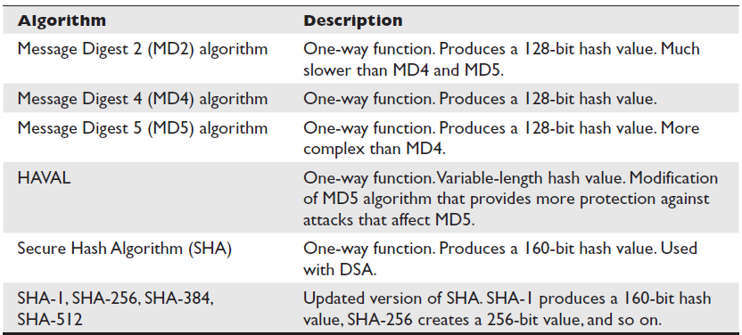
Hash Algorithms

Slide 51
Attacking hash algorithms
Collision – two messages producing the same hash
Birthday attack
253 people to find one that shared your b-day
However, with 23 people in the same room someone will likely share a birthday with someone else.
If a MAC is only 30 bits, it is likely that a collision can be found in 2^30 inputs (2^n where n is # of bits)
Longer hashes are more secure

Slide 52
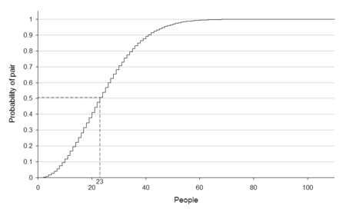

Slide 53
Digital signature
A hash that has been encrypted with senders private key
Integrity , authentication and nonreprudiation.
-----BEGIN PGP SIGNED MESSAGE----- Hash: SHA1
This is some text that I have signed with my DSS/DH key. You can't actually use PGP to verify the signature on this example because, when Web browsers download HTML files to display them, the browsers tend to alter what was uploaded. Thus, unconcerned about verification, I added HTML markups to format the display of this text.
-----BEGIN PGP SIGNATURE----- Version: PGPfreeware 6.5.8
iQA/AwUBP7Z2M4NxG4rj7+GnEQKyPQCfaOxVJCSfv1Ej0W1Leo/FNC+zBSsAoNrC vkPIrX6tsLdCT/uHOXGN06pF =vqQX -----END PGP SIGNATURE-----

Slide 54
PKI
Public Key Infrastructure
Framework for establishing trust in a disbursed environment
Made up of many different parts
Uses symmetric and asymmetric crypto

Slide 55
PKI components
Certificate – mechanism that associates a public key with an owner. Standard: X.509v4
Serial #
Version #
Identity information
Algorithm information
Validity dates
Signature of issuing authority (vouches for the validity of the certificate)

Slide 56
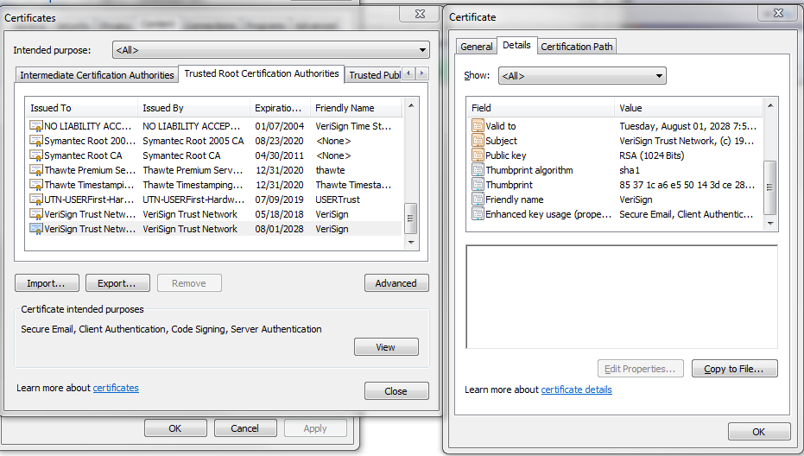
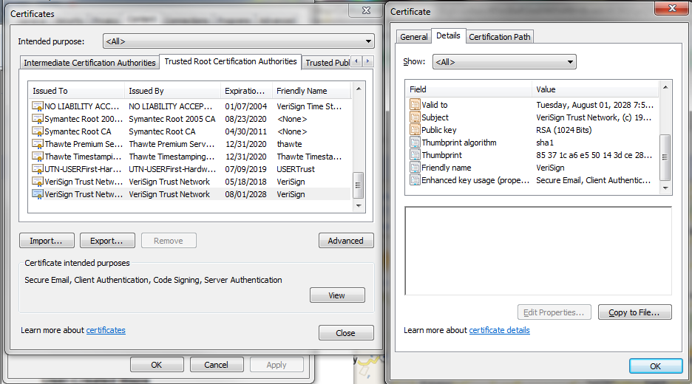

Slide 57
PKI components II
CA – certificate authority – issues, maintains and revokes certificates
Vouches for identity of certificate holder
Certificate holder must have proven their identity when they enrolled for the certificate
CRL – certificate revocation list
OCSP – online certificate status protocol – largely replaces CRL. (Windows 2008)

Slide 58
Steps to get a certificate
Request to RA (Registration Authority – part of CA)
RA requests identification to verify identity.
Once identity is verified, RA forwards certificate request to CA
CA creates certificate with the provided public key embedded and signs it with the CA’s public key
Keypair can be generated on the CA or the client’s machine, depending.

Slide 59
PKI provides
Confidentiality
Access control
Integrity
Authentication
Nonreprudiation

Slide 60
PKI notes
Trust model – chain of trust
Private keys can be compromised (disclosure, hacked computer, etc).
Recovery key – keys can be lost or destroyed. By using multiple keys you have the option for recovering data
Key escrow/backup – enables recovering a lost/deleted key

Slide 61
Link vs. End to End encryption
Link encryption – encrypts everything from end to end (site to site VPN)
End-to-end encryption – headers, addresses, routing and trailers not encrypted. More information ‘leaked’.

Slide 62
Email
MIME – Multipurpose Internet Mail Extension
S/MIME – secure MIME – encrypting and digitally signing e-mail.
PEM – Privacy-Enhanced Mail – not as popular, more structured that S/MIME
MSP – Message Security Protocol – used by the military.
PGP – originally freeware. Uses ‘web of trust’ and key rings.

Slide 63
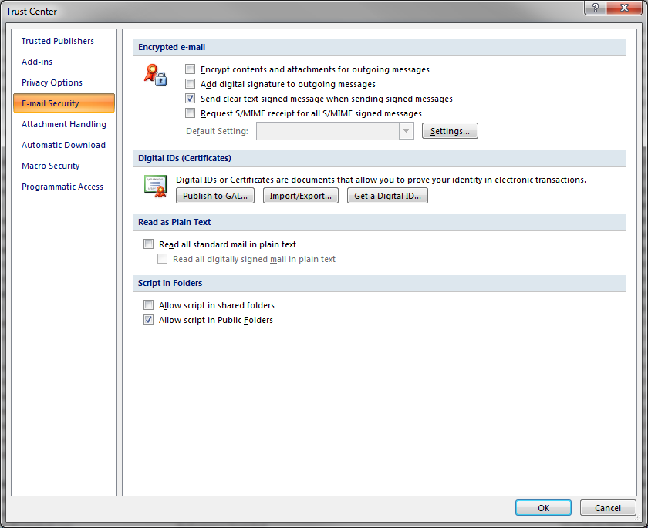

Slide 64
HTTPS
HTTP over SSL
Public key encryption
Encryption
Session key encrypted with the host’s public key
Server authentication
Message integrity
Optional client authentication
SSL can be used for more than HTTP
TLS – replacement for SSL (open standard)
Notes:
P751

Slide 65
IPSEC
Internet Protocol Security – secure channel for protected data between sites.
AH – Authentication Header – authentication protocol (Authentication & Integrity)
NAT breaks this
ESP – Encapsulating Security Payload – authentication, integrity and encryption
This works with NAT
Notes:
P757

Slide 66
IPSEC II
Transport Mode- payload is protected
Tunnel Mode – payload and routing header protected.
SA – Security Association – authentication and encryption keys, algorithms used, key lifetime, source IP
One SA for each direction (Inbound and outbound)
SPI – Security Parameter Index – keeps track of the SAs. Included in IPSec header info.
Notes:
P758

Slide 67
IPSec Key Management
IKE – Internet Key Exchange
ISAKMP – Internet Security Association and Key Management Protocol – framework for key negotiation.
OAKLEY – does the actual key negotiation.
SKIP – Simple Key Management Protocol for IP – alternative to IKE

Slide 68
Cryptographic attacks
Passive attacks – sniffing data on the network
Active attacks – attacker actually does stuff
Cipher-only attack – attacker has encrypted message(s)
Known-Plaintext attack – attacker has plaintext and ciphertext to message(s)
Chosen Plaintext attack – attacker can choose plaintext that gets encrypted
Chosen Ciphertext attack – choose ciphertext to be decrypted

Slide 69
Cryptographic attacks
Differential Cryptoanalysis – compares ciphertext pairs generated by encryption pairs with specific differences. Analyzes the effect.
Statistical Attack – identify weakness in the encryption or the randomness seed(s) (IV)
Side-Channel Attack – looking at timing, power used, amount of time to encrypt, etc.
Replay attack – replaying data that was captured earlier
Notes:
P763

Slide 70
Bonus Lab
Use frequency analysis to break a code
Make sure to include the mapping (a>d, g>o, etc.)
10 points added to quiz grade for full solution only.

Slide 71
Two tools
http://www.simonsingh.net/The_Black_Chamber/frequencypuzzle.htm
Cryptohelper Gary Watson (Java)

Slide 72
